Slide 1
Unit 2: Application Layer

Slide 2
Application Layer:
The application layer enables the user, whether human or software, to access the network. It provides user interfaces and support for services such as electronic mail, remote file access and transfer, shared database management, and other types of distributed information service.
protocol used in application layer are: HTTP,FTP,POP,SMTP,DNS.
Following are list of functions which are performed by Application Layer of OSI Model –
Application Layer provides a facility by which users can forward several emails and it also provides a storage facility.
This layer allows users to access, retrieve and manage files in a remote computer.
This layer provides services which include: e-mail, transferring files, distributing results to the user, directory services, network resources and so on.
It provides protocols that allow software to send and receive information and present meaningful data to users.
This layer allows users to interact with other software applications.

Slide 3
Application Archtecture:
It should be clear that to use the internet we need two application program to interact with each other. One running on a computer somewhere in the world, the other running on another computer somewhere in the world. An application architecture is the way in which the function of the application layer software are spread among the clients and servers in the network.
The work done by any application program can be divided into four general functions which are the basic building blocks of any application:
Data Strage: Most appplication program reqquire data to be stred and retrieved.whether it is a small file such as a memo produced by a word processor or a large database such as an organization's accounting records.
Data accesslogic: The pprocessinf required to acccess data, which oftenmeans database queries in sql.
Application logic:(Some times called business logic), which also can be simple or comlex , depending on the application.
Presentation logic: The presentation of information to the user ad the acceptanceof the user's commands.

Slide 4
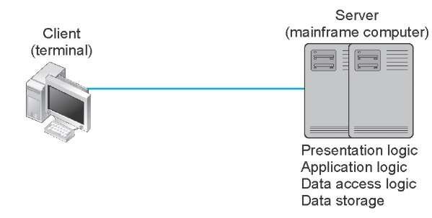
Host-Based Architectures
The very first data communications networks developed in the 1960s were host-based, with the server (usually a large mainframe computer) performing all four functions. The clients (usually terminals) enabled users to send and receive messages to and from the host computer. The clients merely captured keystrokes, sent them to the server for processing, and accepted instructions from the server on what to display.

Slide 5
This very simple architecture often works very well. Application software is developed and stored on the one server along with all data. If you’ve ever used a terminal (or a microcomputer with Telnet software), you’ve used a host-based application. There is one point of control, because all messages flow through the one central server. In theory, there are economies of scale, because all computer resources are centralized (but more on cost later).
There are two fundamental problems with host-based networks. First, the server must process all messages. As the demands for more and more network applications grow, many servers become overloaded and unable to quickly process all the users’ demands. Prioritizing users’ access becomes difficult. Response time becomes slower, and network managers are required to spend increasingly more money to upgrade the server.

Slide 6
Client-Based Architectures
In the late 1980s, there was an explosion in the use of microcomputers and microcomputer-based LANs. Today, more than 90 percent of most organizations’ total computer processing power now resides on microcomputer-based LANs, not in centralized mainframe computers. Part of this expansion was fueled by a number of low-cost, highly popular applications such as word processors, spreadsheets, and presentation graphics programs. It was also fueled in part by managers’ frustrations with application software on host mainframe computers. Most mainframe software is not as easy to use as microcomputer software, is far more expensive, and can take years to develop. In the late 1980s, many large organizations had application development backlogs of two to three years; that is, getting any new mainframe application program written would take years. New York City, for example, had a six-year backlog. In contrast, managers could buy microcomputer packages or develop microcomputer-based applications in a few months.
With client-based architectures, the clients are microcomputers on a LAN, and the server is usually another microcomputer on the same network. The application software on the client computers is responsible for the presentation logic, the application logic, and the data access logic; the server simply stores the data.

Slide 7
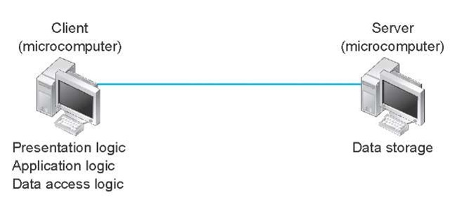
The fundamental problem in client-based networks is that all data on the server must travel to the client for processing. For example, suppose the user wishes to display a list of all employees with company life insurance. All the data in the database (or all the indices) must travel from the server where the database is stored over the network circuit to the client, which then examines each record to see if it matches the data requested by the user. This can overload the network circuits because far more data is transmitted from the server to the client than the client actually needs.

Slide 8
Client-server Architecture:
The Client-server model is a distributed application structure that partitions task or workload between the providers of a resource or service, called servers, and service requesters called clients. In the client-server architecture, when the client computer sends a request for data to the server through the internet, the server accepts the requested process and deliver the data packets requested back to the client. Clients do not share any of their resources. Examples of Client-Server Model are Email, World Wide Web, etc.
How the Client-Server Model works ?
In this article we are going to take a dive into the Client-Server model and have a look at how the Internet works via, web browsers. This article will help us in having a solid foundation of the WEB and help in working with WEB technologies with ease.
Client: When we talk the word Client, it mean to talk of a person or an organization using a particular service. Similarly in the digital world a Client is a computer (Host) i.e. capable of receiving information or using a particular service from the service providers (Servers).
Servers: Similarly, when we talk the word Servers, It mean a person or medium that serves something. Similarly in this digital world a Server is a remote computer which provides information (data) or access to particular services.

Slide 9
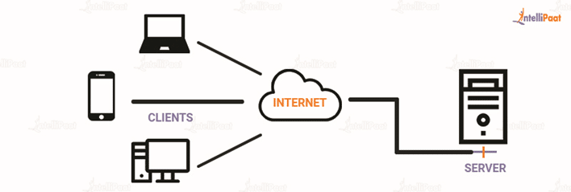
Advantages of Client-Server model:
Centralized system with all data in a single place.
Cost efficient requires less maintenance cost and Data recovery is possible.
The capacity of the Client and Servers can be changed separately.
Disadvantages of Client-Server model:
Clients are prone to viruses, Trojans and worms if present in the Server or uploaded into the Server.
Server are prone to Denial of Service (DOS) attacks.
Data packets may be spoofed or modified during transmission.
Phishing or capturing login credentials or other useful information of the user are common and MITM(Man in the Middle) attacks are common.

Slide 10
1-tier architecture
In 1-tier architecture, the presentation, application server, and data layers are all stored on a single device or a shared storage device. A good example is a desktop application that works offline and stores all its data on the same device it's running from.
2-tier architecture
In 2-tier architecture, the presentation and application server are stored on the client while the data layer is stored on a server. So as long as the code of an application is fully executed on the client and some of the data is being stored in a remote database, that application fits the 2-tier architecture criteria. A desktop application that requires you to log into an online account is a good example.
3-tier architecture
The presentation layer is stored on the client, Application server is stored on one server, and the data layer is stored on another server. For example, you use a smartphone app’s user interface to interact with an app while an application server executes most of the app’s code and a database server stores the data

Slide 11
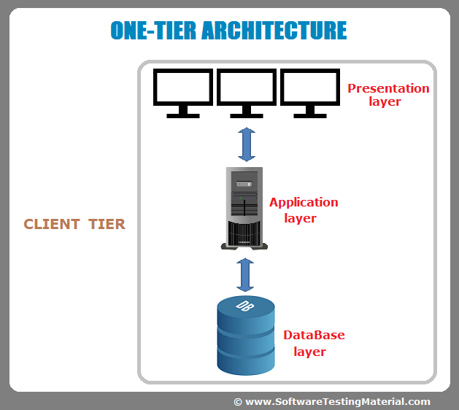
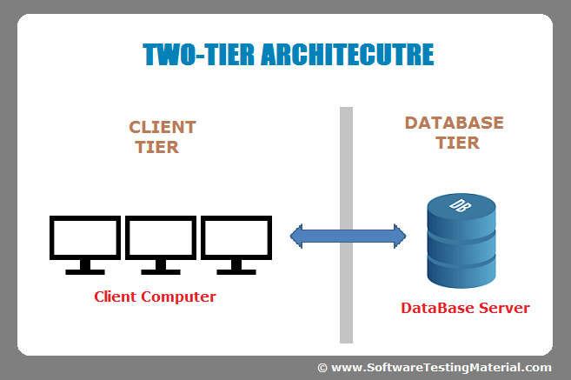
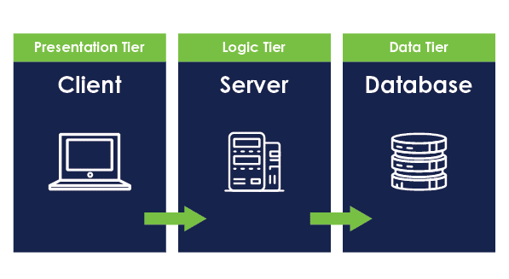
Three Tier Architecture

Slide 12
WWW:
"WWW" stands for World Wide Web.
It is a system of interlinked hypertext documents and multimedia content that is accessed via the internet using web browsers.
The World Wide Web is a part of the internet and allows users to navigate between web pages by clicking on hyperlinks.
It was invented by Sir Tim Berners-Lee in 1989 and has since become a fundamental aspect of the internet, enabling the sharing and accessing of information, resources, and services across the globe.
The prefix "www" is commonly used in URLs (Uniform Resource Locators) to identify web pages on the World Wide Web.

Slide 13
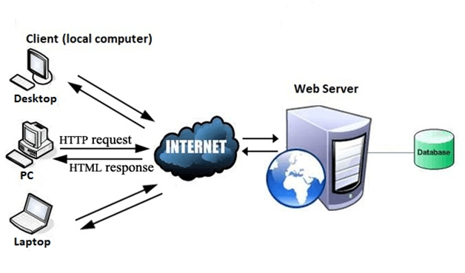
Working of WWW:
The Web works as per the internet's basic client-server format as shown in the following image. The servers store and transfer web pages or information to user's computers on the network when requested by the users. A web server is a software program which serves the web pages requested by web users using a browser. The computer of a user who requests documents from a server is known as a client. Browser, which is installed on the user' computer, allows users to view the retrieved documents.

Slide 14
The World Wide Web (WWW) operates through a combination of various technologies and protocols that enable the creation, retrieval, and display of web content. Here's an overview of how the WWW works:
Hypertext Markup Language (HTML): Web content is primarily written in HTML, a markup language that structures the content on a web page. HTML uses tags to define elements such as text, images, links, and other multimedia components.
Uniform Resource Locator (URL): Each resource on the web, such as a web page or an image, is identified by a unique address called a URL. A URL consists of various components, including the protocol (usually "http" or "https"), the domain name, and the specific path to the resource.
Hypertext Transfer Protocol (HTTP) and HTTPS: HTTP is the protocol used for transferring data on the web. When you enter a URL in your browser, it sends an HTTP request to the server hosting the web page. HTTPS is a secure version of HTTP that uses encryption (SSL/TLS) to protect the data during transmission.

Slide 15
Web Browsers: Browsers are applications that interpret HTML and other web technologies to render web pages. Popular web browsers include Chrome, Firefox, Safari, and Edge. Browsers handle the presentation layer, displaying text, images, and multimedia content in a user-friendly format.
Web Servers: These are computers or systems that host websites and respond to HTTP/HTTPS requests. When you enter a URL, your browser sends a request to the corresponding web server, which then processes the request and returns the necessary data to be displayed on your browser.
Domain Name System (DNS): The DNS translates human-readable domain names (e.g., www.example.com) into IP addresses, which are numerical identifiers used by computers to locate each other on the network. This translation is essential for routing requests to the correct web server.
Hyperlinks: Hyperlinks or links are elements on web pages that allow users to navigate between different resources on the web. When you click on a link, your browser sends a new request to the server, and the corresponding web page is retrieved and displayed.
Web Standards and Protocols: The WWW operates based on a set of standards and protocols, such as HTML, CSS (Cascading Style Sheets), and JavaScript for front-end development, and protocols like HTTP/HTTPS for communication between browsers and servers.

Slide 16
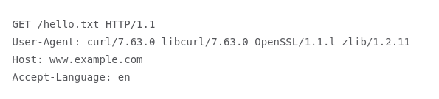
HTTP
HTTP stands for Hypertext Transfer Protocol, and it is a protocol – or a prescribed order and syntax for presenting information – used for transferring data over a network. Most information that is sent over the Internet, including website content and API calls, uses the HTTP protocol. There are two main kinds of HTTP messages: requests and responses.
HTTP requests are generated by a user's browser as the user interacts with web properties. For example, if a user clicks on a hyperlink, the browser will send a series of "HTTP GET" requests for the content that appears on that page. If someone Googles "What is HTTP?" and this article shows up in the search results, when they click on the link, their browser will create and send a series of HTTP requests in order to get the information necessary to render the page.

Slide 17
When an origin server receives an HTTP request, it sends an HTTP response, which is similar to:
HTTP/1.1 200 OK
Date: Wed, 30 Jan 2019 12:14:39 GMT
Server: Apache
Last-Modified: Mon, 28 Jan 2019 11:17:01 GMT
Accept-Ranges: bytes
Content-Length: 12
Vary: Accept-Encoding
Content-Type: text/plain

Slide 18
HTTP | HTTPS
The full form of HTTP is the Hypertext Transfer Protocol. | The full form of HTTPS is Hypertext Transfer Protocol Secure.
It is written in the address bar as http://. | It is written in the address bar as https://.
The HTTP transmits the data over port number 80. | The HTTPS transmits the data over port number 443.
It is unsecured as the plain text is sent, which can be accessible by the hackers. | It is secure as it sends the encrypted data which hackers cannot understand.
It is mainly used for those websites that provide information like blog writing. | It is a secure protocol, so it is used for those websites that require to transmit the bank account details or credit card numbers.
It is an application layer protocol. | It is a transport layer protocol.
It does not use SSL. | It uses SSL that provides the encryption of the data.
Google does not give the preference to the HTTP websites. | Google gives preferences to the HTTPS as HTTPS websites are secure websites.
The page loading speed is fast. | The page loading speed is slow as compared to HTTP because of the additional feature that it supports, i.e., security.

Slide 19
EMAIL:
Email stands for Electronic Mail. It is a method to send messages from one computer to another computer through the Internet. It is mostly used in business, education, technical communication, and document interactions. In 1971, a test email was sent Ray Tomlinson to himself containing text.
It is the information sent electronically between two or more people over a network. It involves a sender and receiver/s.
What it is:
A way to send and receive messages from other people over the internet.
Messages are stored electronically on servers until the recipient retrieves them.
Can include text, images, videos, and other attachments.
Used for both personal and professional communication

Slide 20
SMTP Fundamentals
SMTP is an application layer protocol. The client who wants to send the mail opens a TCP connection to the SMTP server and then sends the mail across the connection. The SMTP server is an always-on listening mode. As soon as it listens for a TCP connection from any client, the SMTP process initiates a connection through port 25. After successfully establishing a TCP connection the client process sends the mail instantly.
Model of SMTP System
In the SMTP model user deals with the user agent (UA), for example, Microsoft Outlook, Netscape, Mozilla, etc. In order to exchange the mail using TCP, MTA is used. The user sending the mail doesn’t have to deal with MTA as it is the responsibility of the system admin to set up a local MTA. The MTA maintains a small queue of mail so that it can schedule repeat delivery of mail in case the receiver is not available. The MTA delivers the mail to the mailboxes and the information can later be downloaded by the user agents.

Slide 21
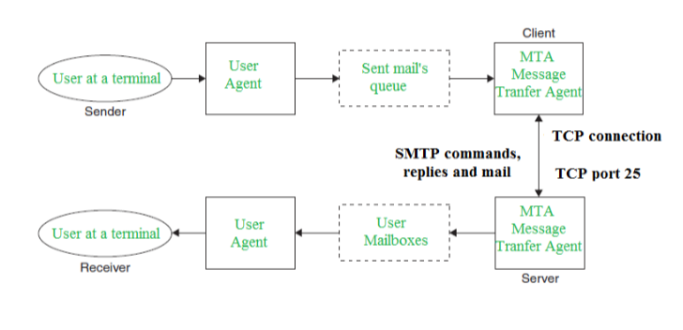

Slide 22
Components of SMTP
Mail User Agent (MUA)
Mail Submission Agent (MSA)
Mail Transfer Agent (MTA)
Mail Delivery Agent (MDA)
1. Mail User Agent (MUA): It is a computer application that helps you in sending and retrieving mail. It is responsible for creating email messages for transfer to the mail transfer agent(MTA).
2. Mail Submission Agent (MSA): It is a computer program that basically receives mail from a Mail User Agent(MUA) and interacts with the Mail Transfer Agent(MTA) for the transfer of the mail.
3. Mail Transfer Agent(MTA): It is basically software that has the work to transfer mail from one system to another with the help of SMTP.
4. Mail Delivery Agent(MDA): A mail Delivery agent or Local Delivery Agent is basically a system that helps in the delivery of mail to the local system

Slide 23
Multipurpose Internet Mail Extension (MIME) is a standard that was proposed by Bell Communications in 1991 in order to expand the limited capabilities of email.
MIME is a kind of add-on or a supplementary protocol that allows non-ASCII data to be sent through SMTP. It allows the users to exchange different kinds of data files on the Internet: audio, video, images, application programs as well.
Features of MIME –
It is able to send multiple attachments with a single message.
Unlimited message length.
Binary attachments (executables, images, audio, or video files) may be divided if needed.

Slide 24
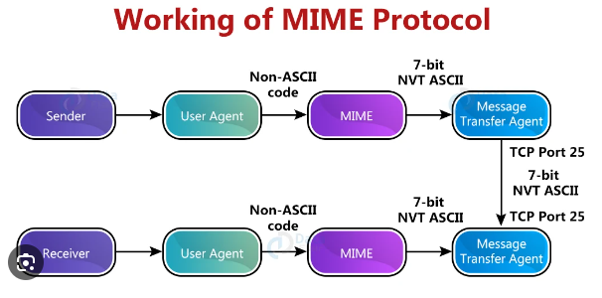

Slide 25
Working of MIME –
Suppose a user wants to send an email through a user agent and it is in a non-ASCII format so there is a MIME protocol that converts it into 7-bit NVT ASCII format. The message is transferred through the e-mail system to the other side in the 7-bit format now MIME protocol again converts it back into non-ASCII code and now the user agent of the receiver side reads it and then information is finally read by the receiver. MIME header is basically inserted at the beginning of any e-mail transfer.

Slide 26
Telnet is a network protocol used on the Internet or local area networks to provide a bidirectional interactive text-oriented communication facility using a virtual terminal connection. The term "telnet" can refer to both the protocol and the software that implements it.
Here are the key aspects of Telnet:
Protocol: Telnet operates on top of the Transmission Control Protocol (TCP) and provides a simple, text-based way for two devices to communicate over a network. It allows a user on one computer to log into another computer on the same network, essentially providing a terminal-like interface to the remote system.
Terminal Emulation: Telnet allows a user to access a remote system's command-line interface as if they were physically present at that system. It provides terminal emulation, transmitting keystrokes and receiving output text.
Port Number: The default port for Telnet is 23. When you connect to a device using Telnet, you typically specify the host (remote server) and the port number (default is 23).

Slide 27
Security Concerns: Telnet transmits data, including login credentials, in plain text, making it insecure for use over untrusted networks such as the Internet. For secure remote access, protocols like SSH (Secure Shell) are recommended over Telnet.
Usage: While Telnet was once widely used for remote administration of servers and network devices, its usage has declined in favor of more secure alternatives. SSH has largely replaced Telnet in many scenarios due to its encryption and improved security features.

Slide 28
Video Conferencing:
Videoconferencing is a technology that enables individuals or groups in different locations to hold face-to-face meetings without having to move to a single location physically. It allows participants to see and hear each other in real-time, making it a valuable tool for communication, collaboration, and virtual meetings. Videoconferencing systems typically involve the use of audio and video equipment, as well as software to facilitate communication.
The transmission of video requires a lot of netowrk capacity. Most videoconferencing uses data compressionto reduew the amount of data transmitted. Surprisingly , the most common complaint is not the quality of the video imagebut the quality of the voice transmission.Special care needs to be taken in the design and placement of microphone and speakers to ensure quality sound and minimal feedback.

